Slide 1
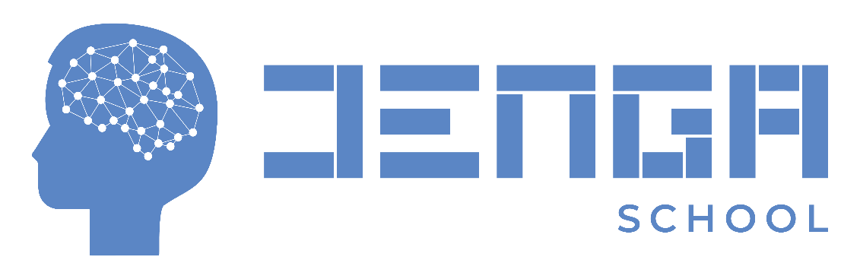
Black-jack Game
Name: Edwin Munyiri King’ori
Program: PYTHON PROGRAMMING FOR ALL
Date:

Slide 2
PROBLEM STATEMENT
I completed the project to enhance the skills and knowledge acquired during the classwork. The project entails automating a blackjack game on a command line interface.
Blackjack is a popular card game played in casinos around the world. The main objective of the game is to have a hand of cards whose total value is equal to or close to 21 without surpassing.
Before the game begins, players place their bets by placing chips on the designated betting area on the table.

Slide 3
PROBLEM STATEMENT
The dealer gives two cards to each player and retains two cards to themselves. The dealer's first card is dealt face up, while the second card is dealt face down.
Calculating the hand value: Players add up the total value of their cards. Cards 2 through 10 are worth their face value, face cards (Kings, Queens, and Jacks) are worth 10 points each, and Aces can be worth 1 or 11 points, depending on the player's choice.
Playing the hand: The player can choose to "hit" (ask for another card) to increase their hand value, or "stand" (keep their current hand). Players can continue to hit until they decide to stand or their hand value exceeds 21.
Dealer's turn: After all players have completed their turns, the dealer reveals their face-down card. If the dealer's hand is less than 17, they must continue to hit until their hand value is 17 or greater. If the dealer's hand exceeds 21, all remaining players win.

Slide 4
PROBLEM STATEMENT
Determining the winner: The player with a hand value closer to 21 than the dealer's hand value wins. If the player's hand value exceeds 21, they lose the game. If the player and dealer have the same hand value, it's a tie, and the player's bet is returned.

Slide 5
Project goals
The main goal programming the blackjack game help me improve my python programming skills and gain experience with various concepts and tools such as using functions, classes, loops, methods and objects.
Combining the use of python data structures, functions, classes and loops helped me to think critically and logically to implement the game's rules and mechanics.
Attempting to automate the game provided a fun learning experience and the goals was to experience an engaging approach to learn skills that could be applied in real-world applications.

Slide 6
Methods and tools
I wrote the code in Python 3 and utilized Visual Studio Code that as an integrated terminal, which allowed me to debug and check the required output.
The first step was to define the game's rules and structure. The game required a deck of cards, a dealer, and one or more players. The deck of cards could be created using Python's built-in data structures, such as lists and dictionaries.
Once the game's rules and structure were defined, the next step was to write the code that implemented the game's logic. Using Visual studio code helped to write, test, and debug the code until I had a working game.

Slide 7
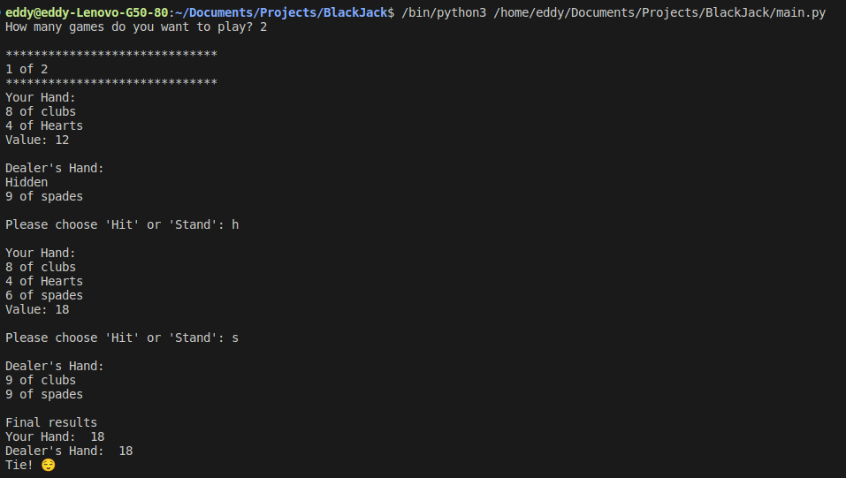
results

Slide 8
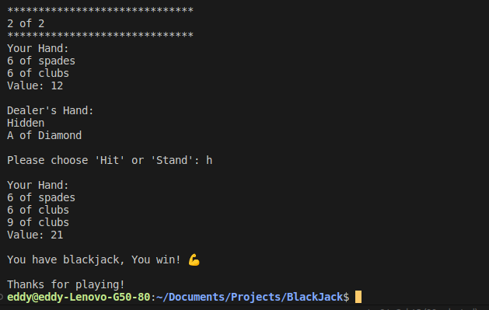
results

Slide 9
conclusion
Improvements
Developing a user interface using Django is a great way to enhance user-friendliness for a Black jack game application. Django is a popular web framework that provides several tools and libraries that make web development easier and faster. By using Django to develop a user interface, we can provide users with a graphical user interface (GUI) for playing the Black jack game, which is more user-friendly than a command-line interface (CLI).

Slide 10
conclusion
Observation
Python is a popular high-level programming language that is easy to learn and use. Learning Python programming can be achieved through various resources, including books, online courses, tutorials, and practice exercises. If you find that Python programming is not taught in detail in your current course or program, there are plenty of resources available to learn on your own.
Class inheritance is a powerful feature of object-oriented programming that allows classes to inherit attributes and methods from other classes. To learn about class inheritance in Python, one approach is to start with the basics of object-oriented programming and gradually work up to more complex concepts such as inheritance. Online resources such as tutorials, videos, and articles can be helpful in learning about Python class inheritance.

Slide 11
conclusion
Challenges faced
Implementing classes and their different methods, such inheritance, in my code was difficult for me. To learn more about its applications, I used the tutorials and the materials given in class. The courses also aided me in overcoming obstacles I ran into while writing the code, and I can now say that it was a worthy task.
Abstraction: Abstraction is a crucial concept in OOP, which involves breaking down complex problems into simpler, more manageable parts. It can be challenging to identify the right level of abstraction and ensure that your code is modular and easy to read.

Slide 12
conclusion
Debugging: Debugging is a necessary part of programming, and it can be time-consuming and frustrating. Learning how to debug your code and identify and fix errors is a crucial skill for any programmer.

